Slide 1
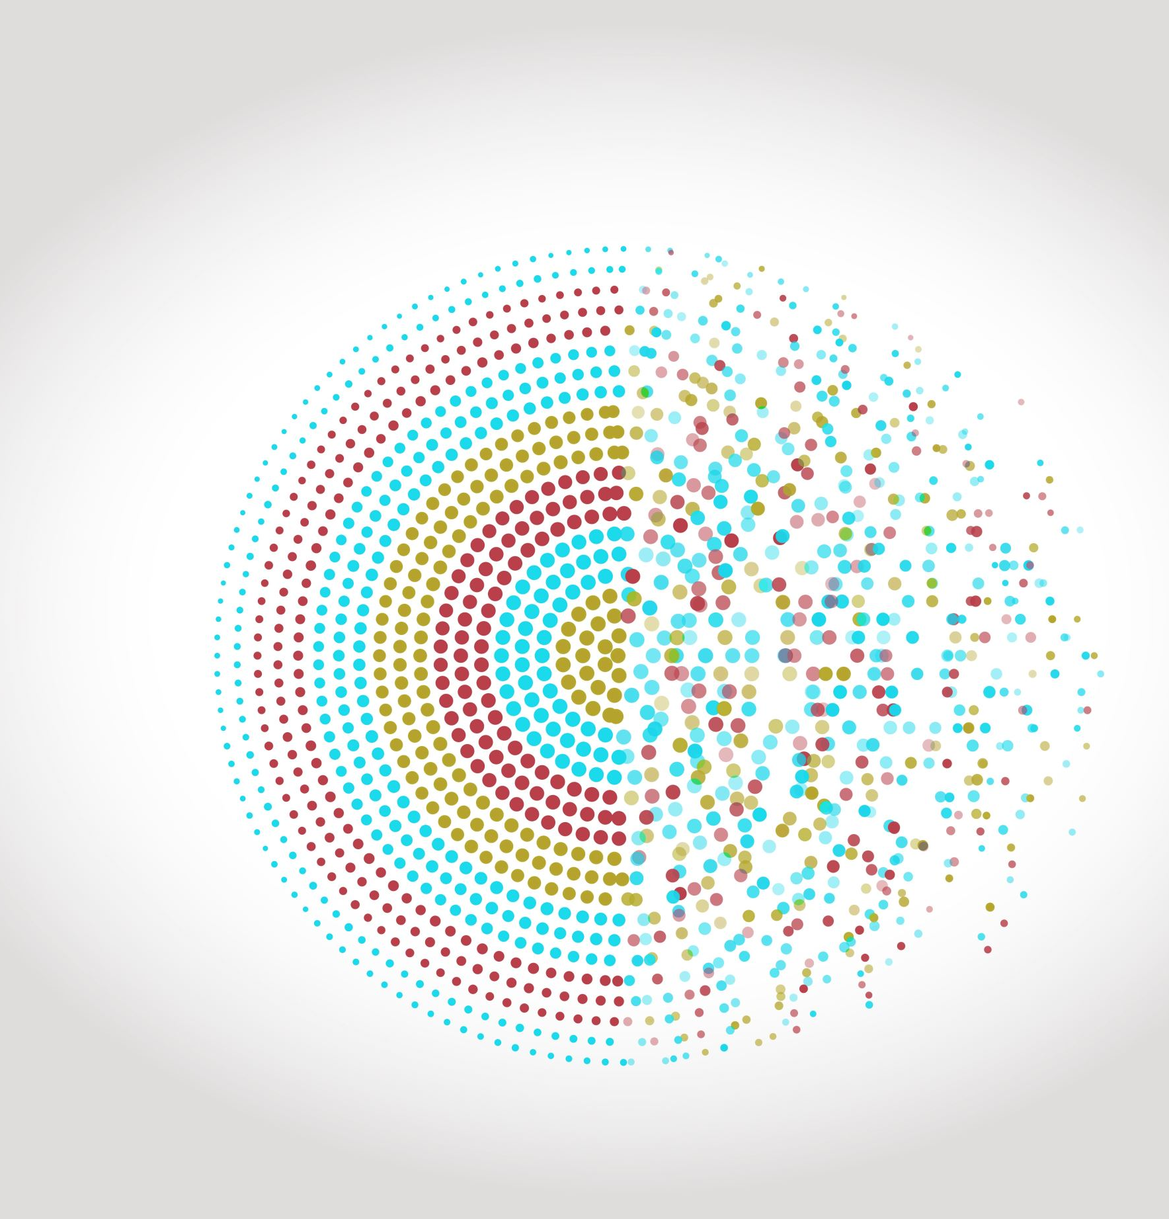
MSDS 7335 Final Project Summer 2025
Cursor AI: Application in LLM
Tue Vu

Slide 2
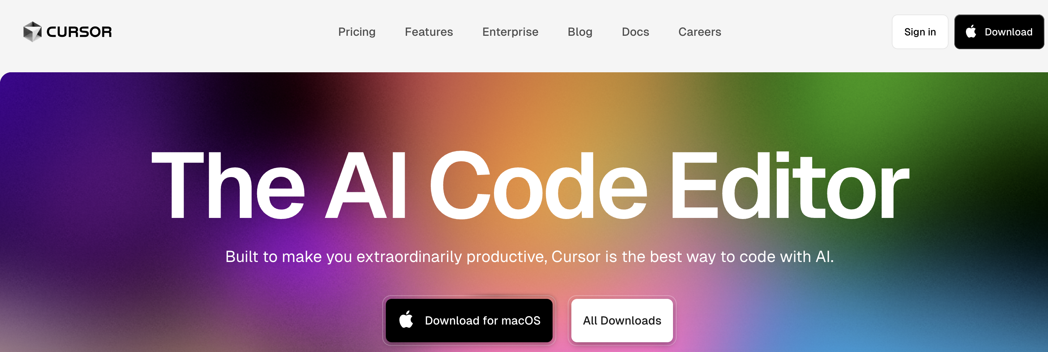
Cursor
AI assisted IDE
Proprietary software by Anysphere lab, Found by 4 MIT grads in 2022
Value at 9B in May 2025

Slide 3
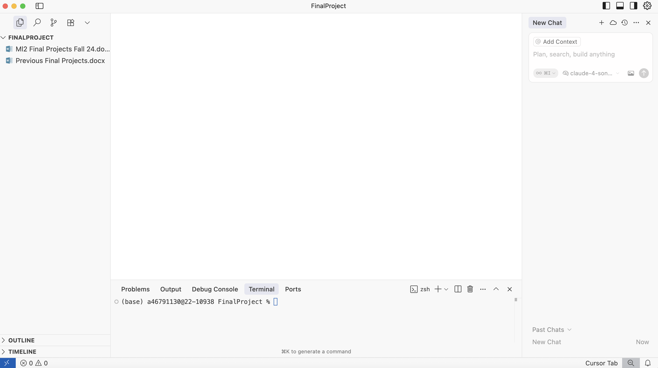

Slide 4
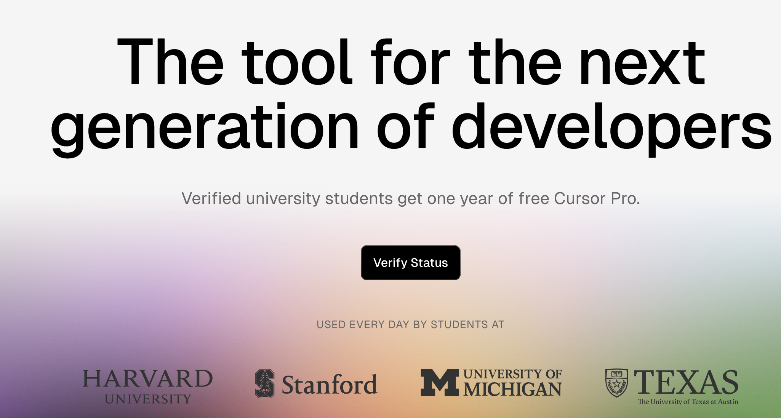

Slide 5
End to End workflow with Cursor.com Demonstration
Create Chatbot with RAG
GUI by Gradio
Test run from local
Hosted run by Cloud
Hosted run by Open OnDemand for HPC using GPU
Upload the project to Github to share
Write a comprehensive report

Slide 6
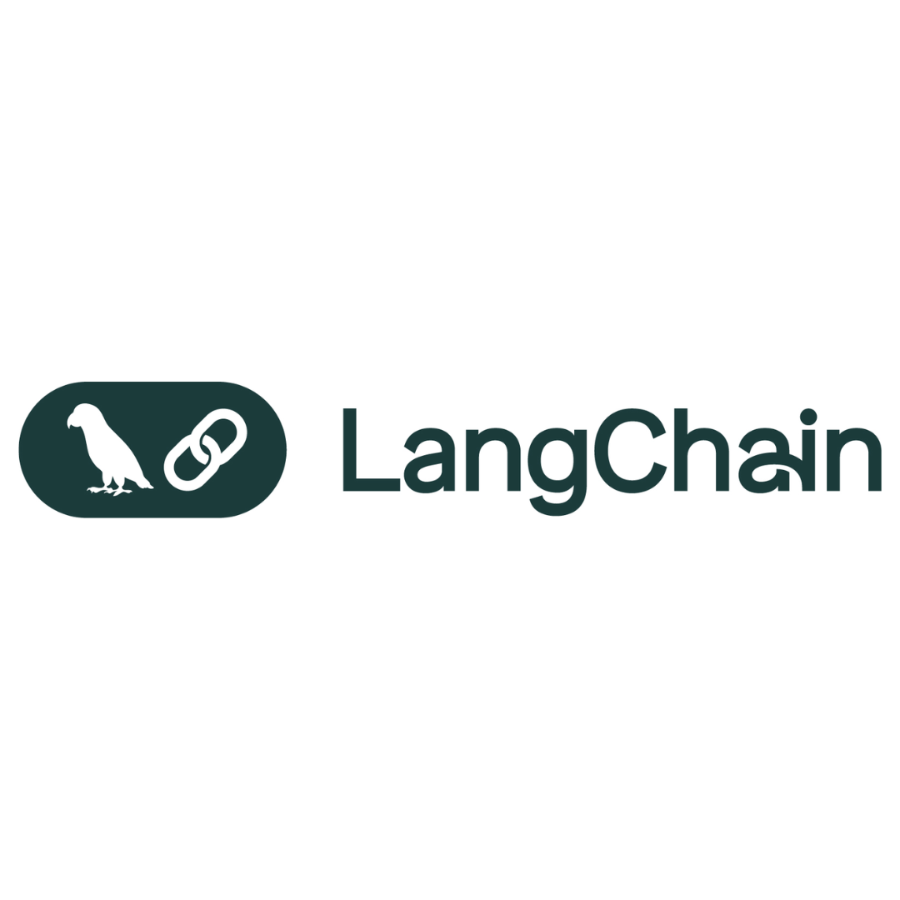
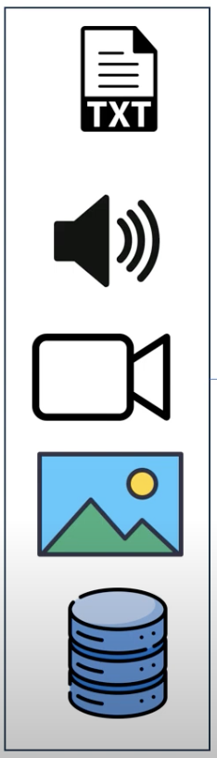





Question
Ollama Embedding
Ollama LLMs
Response
Gradio App GUI

Slide 7
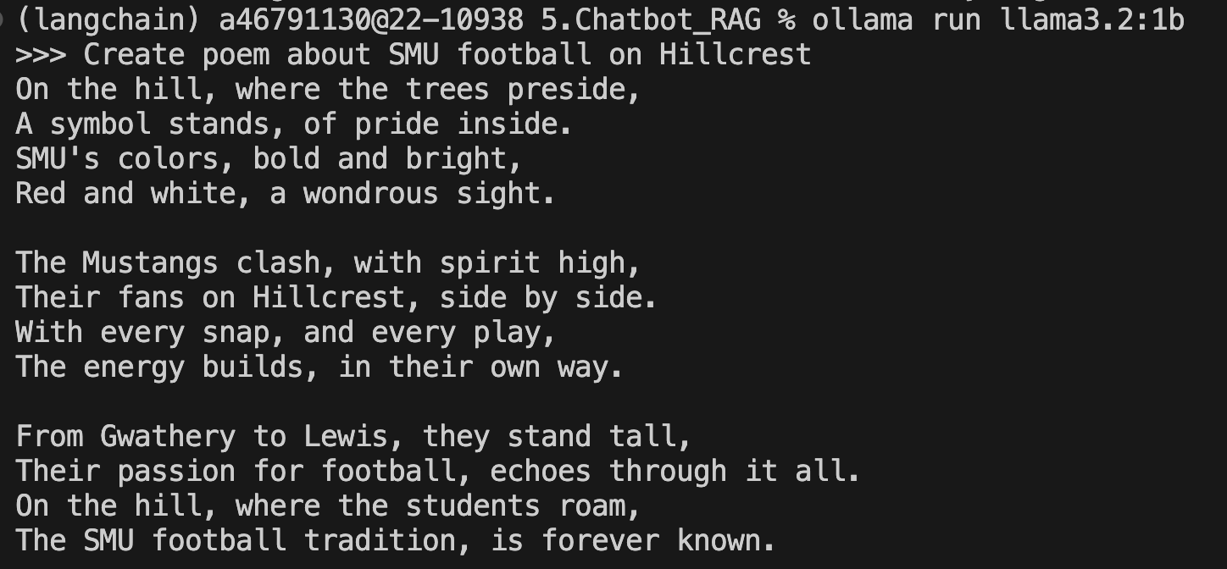
Ollama Models
Open-source tool empower to run LLM locally on your system
Download LLM locally (Llama, Phi, Mistral, Deepseek, Qwen)
Run locally without cloud
No API
Use your own data
Simple command

Slide 8
Langchain Models
Open-source tool framework to build application with LLMs
Chain construction: combine multiple LLMs call and operate into pipeline:
i.e: retrieve data => summarize => answer
Memory support in conversational workflow
Support API call (OpenAI API)
Incorporate: PDF parsing, Webscraping, Database connection
Multimodal file: text, word, pdf, audio, videos, images

Slide 9
Gradio
Open-source Python library that allows developers to quickly create user interfaces (GUIs) for machine learning models, APIs, or any Python function.
Popular and run on different platform: local PC, HPC, Cloud
Many popular model utilized Gradio, such as the famous Stable Diffusion model A1111, Dall-E mini, Llama-Factory

Slide 10

Why RAG
Missing/Limited/Personal/Private data
Pre-trained model did not cover entire everything
A lot of missing or never been trained data
Privacy data
Avoid Hallucination
RAG provides instance solutions
Use real-time retrieval from external database
Ensure up to date information

Slide 11
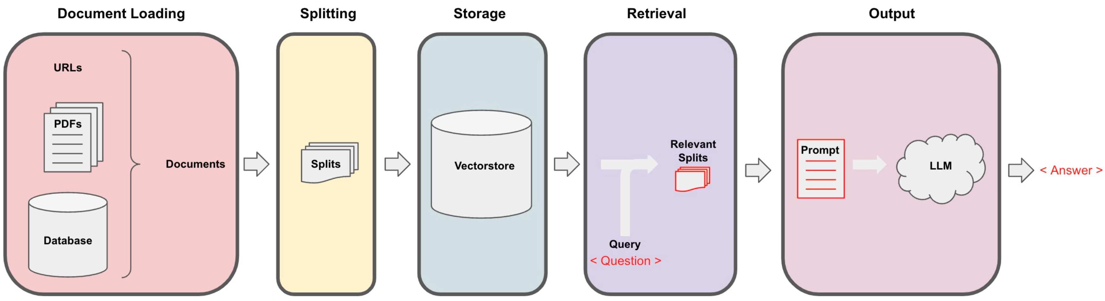
RAG Diagrams via Gradio app
Ollama Embedding
Ollama LLM

Slide 12
Prompts:
Prompt 1:
I want to build a RAG chatbot with the following configuration:
Do not use API to call LLMs, instead using local Ollama resources with ollama already served
From Ollama, use the default LLM gemma3:1b.
For embedding LLM, use mxbai-embed-large:335m
For the RAG framework, execute via Langchain.
For GUI, use Gradio. I want to have a button to upload multiple files with type of pdf or text, a dropdown box to choose LLM models: gemma3:1b, deepseek-r1:1.5b, llama3.2:1b, qwen2.5vl:3b, a slide bar for temperature parameter control for LLM with the range from 0 to 1, choose the default temperature of 0.5 and a chat box where I can ask the model and a big text box to display the answer.
The uploaded file after embedding will be saved to chromadb folder and removed after next upload file or model exiting
Write everything into 1 python file called TueChatRag.py

Slide 13
Prompts:
Prompt 2:
Write a report in Latex format to explain what I did, this is the final project for MSDS7335, following the content in MSDS7335_Presentation.pptx saved in report folder, including 4 chapters:
Chapter 1: Introduction about the work with the main objective is to use cursor.com (cursor AI) to automatic create a Chatbot with RAG for sensitive data querying. No API involved and only run in local PC or local HPC or on cloud via AWS
Chapter 2: Models and Data: Introduce Ollama, Langchain , RAG, Gradio and the RAG workflow from uploading data to embedding and creating chromadb then extracting the answer for LLMs.
Chapter 3: Automated the workflow via Cursor.com, creating the chatbot in python then Deploy the chatbot with different methods: via local PC, via HPC via Open Ondemand or via Cloud using AWS service
Chapter 4: Discussions and Conclusion, specifying the necessity of cursor.com in this workflow.
Save all report latex in report folder

Slide 14

Demonstration
Create Chatbot with framework from Ollama, Langchain, Gradio using Cursor
Create report
Upload entire workflow to github

Slide 15
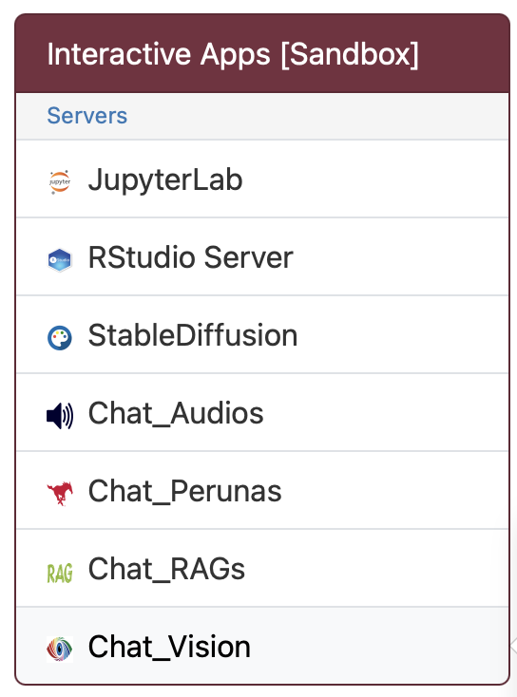
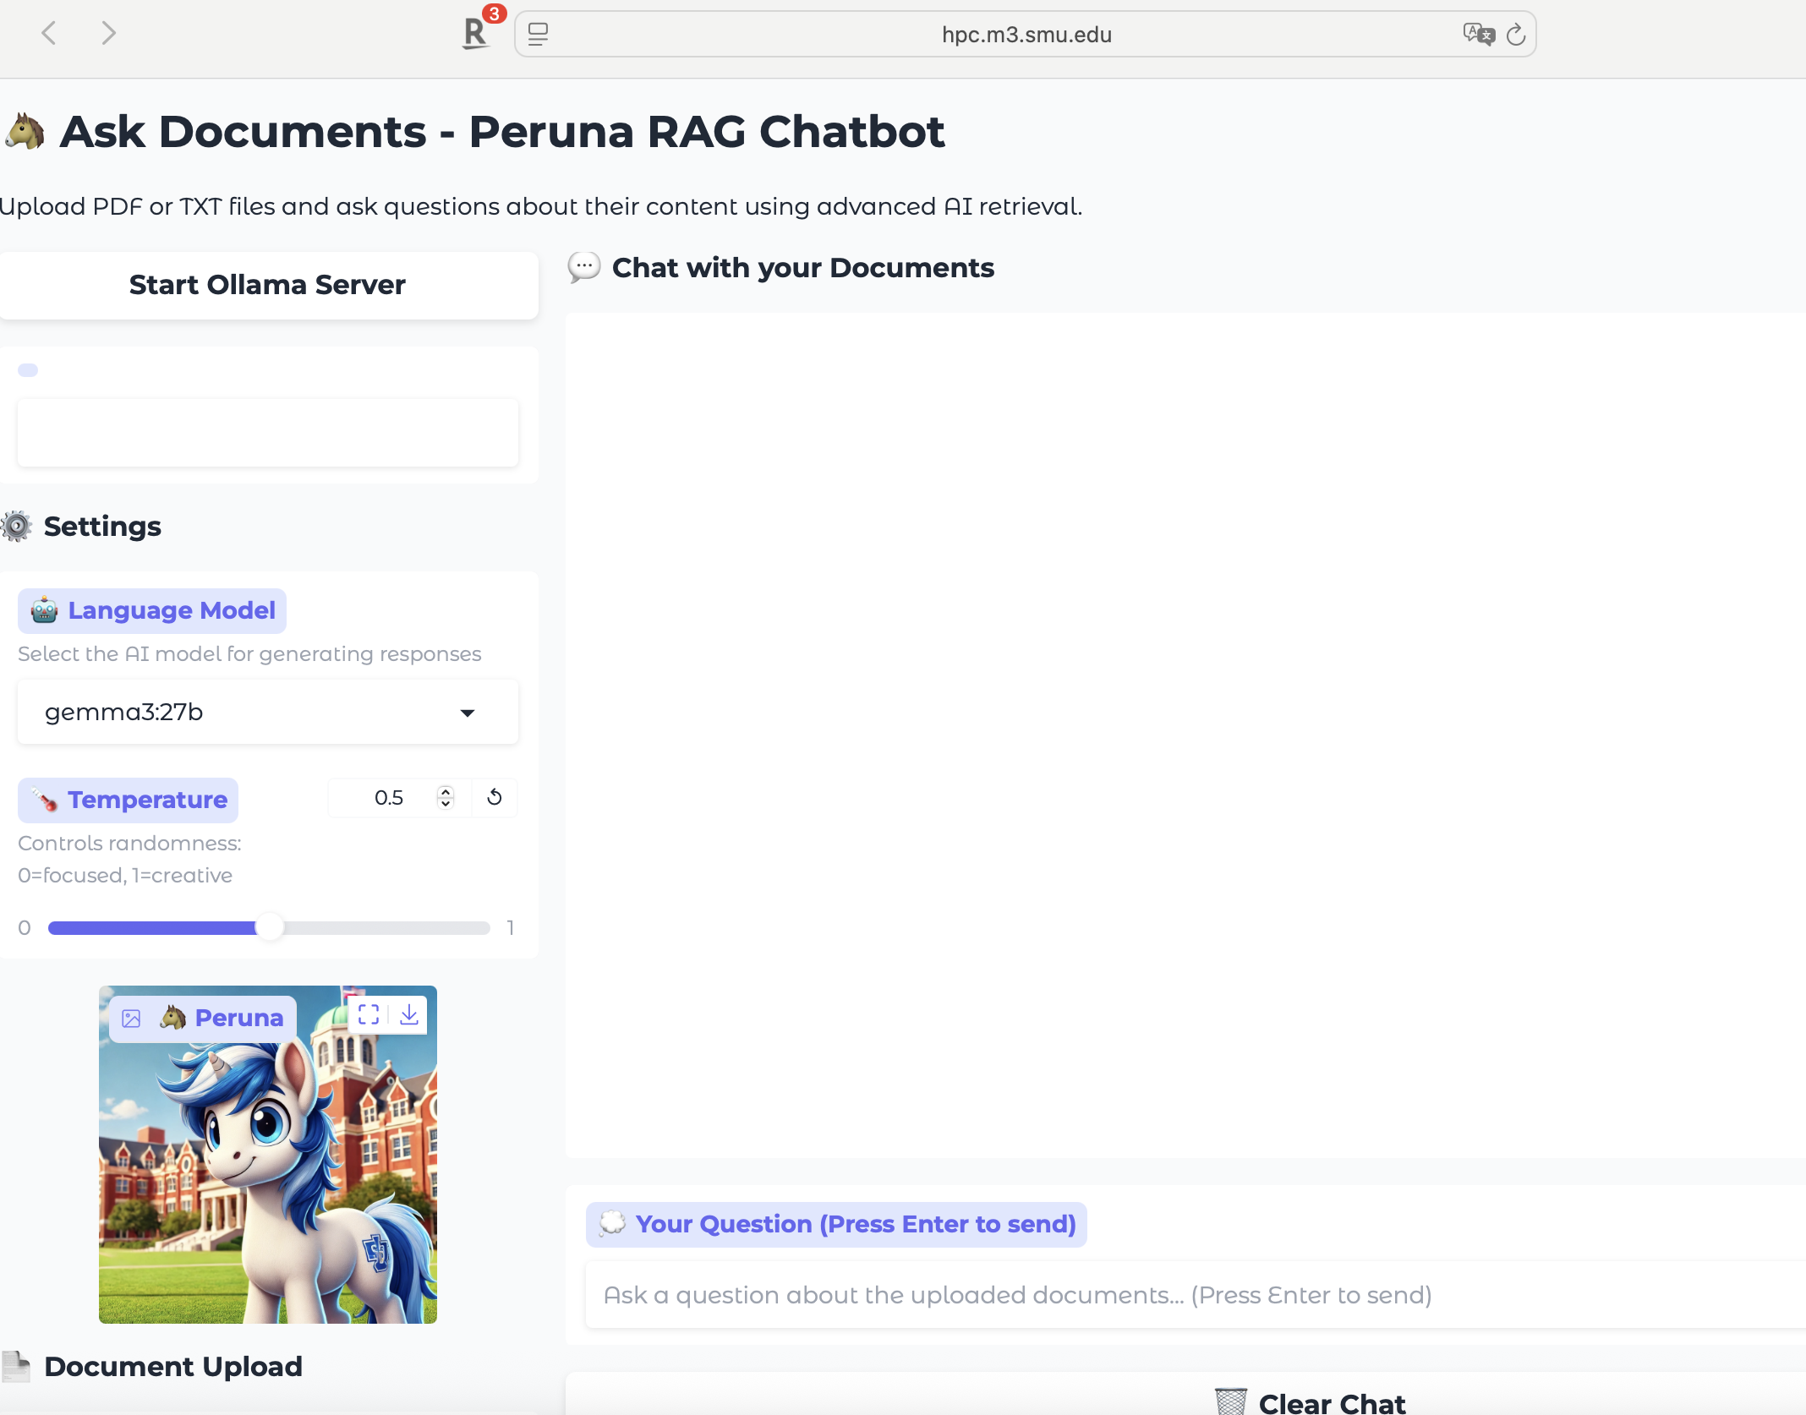
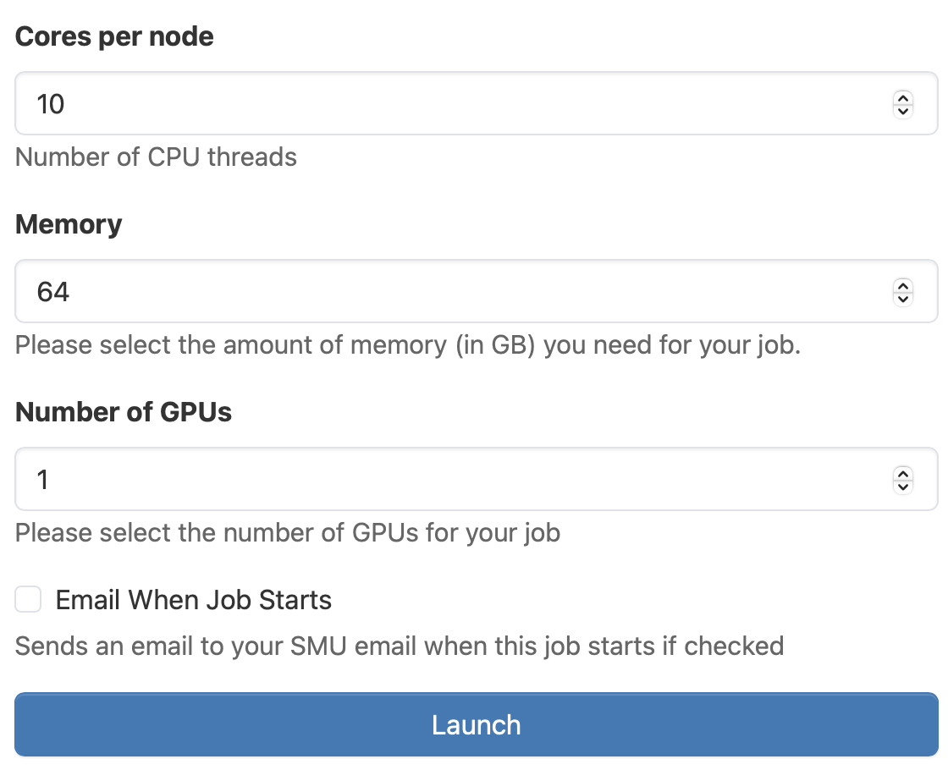

Slide 16
